Slide 1
Formula SAE
Powertrain
Damian Boniella
Matt Gingold
Tobin Lanford
Lucille Longhurst
Joey LeBlanc

Slide 2
AGENDA
01
02
03
04
05
06
PROJECT DESCRIPTION
DESIGN REQUIREMENTS
DESIGN DESCRIPTION
ENGINEERING CALCULATIONS
DESIGN VALIDATION
SCHEDULE & BUDGET

Slide 3

PROJECT DESCRIPTION: OVERVIEW
Formula SAE: An engineering competition where student teams design, build, and race small, single-seater, open-wheel race cars [1].
  Powertrain is the system in the vehicle that is responsible for generating and delivering power to the wheels and enabling vehicle motion.
FSAE is important for promoting careers and excellence in engineering as it encompasses research, design, manufacturing, testing, developing, marketing, managing, and financing within the automotive industry [1].
The project is sponsored by business willing to donate money/materials in exchange for exposure.
Purpose of FSAE:
Educational Experience
Performance Optimization
Professional Exposure and Industry Sponsorship

Slide 4
Design Requirements: CR & ER
Customer Requirements:
Functional Drivetrain: The team wants our drivetrain to be reliable and operate smoothly for our drivers.
Clean Wiring: The team wants professional and clean wiring throughout the vehicle for aesthetic and ease of problem-solving purposes.
Engine Runs after Brake Test: For technical inspection, the vehicle must lock up all four wheels and have the engine running at the end of the test to complete the test.
Ease of Service: The drivetrain must be easy to repair in case of a part failure.
Interchangeability of Parts: Parts used within the drivetrain system must be easy to change and still work as intended.
Design Meets all Competition Rules: All aspects of the drivetrain system must be rule compliant.
Safety: The vehicle must be safe for all drivers and spectators around it.
Cost: The vehicle cost must be reasonable for the team to work with.
Ease of Shifting: The drivetrain system must be easy to shift and shift smoothly.
Engineering Requirements:
Functionality: All systems within the drivetrain system must work repeatedly without a failure. Target: Yes.
Under 710cc: The engine used must be under 710cc to meet competition rules. Target: 600cc.
Power to Weight Ratio: The team needs to maximize the power to weight ratio to maximize vehicle’s performance. Target: 0.25 hp/lb.
Manufacturability: Manufactured parts within the drivetrain system must be quick and easy to manufacture. Target: Two weeks.
Dynamometer Tuned: To maximize the performance of the vehicle, the vehicle must be dynamometer tuned. Target: Yes.
Cost: The cost of the drivetrain system must be reasonable for the team to work with. Target: $14,207.
Ease of Diagnostics: The drivetrain system must be easy to diagnose problems when they occur. Target: 15 minutes.
Center of Gravity: The vehicle needs a low center of gravity to pass the tilt test which tests the amount of g’s your vehicle can handle. Target 10 in. off the ground.

Slide 5
Design Requirements: CR & ER
Customer Requirements:
Usable Powerband: The drivetrain must perform optimally through the powerband with our given restrictions.
Sound: The exhaust system must meet competition requirements and not harm drivers' or spectators' hearing.
Chain Tension Adjustability: The powertrain system must have adjustable chain tensioning to account for chain slack and stretching.
Body Roll: Vehicle body roll must be kept to a minimum to increase performance by distributing engine weight.
Acceleration Rating: The team will need a high acceleration rating to score well in the drag race event.
Horsepower Rating: The team will need a high horsepower rating for better performance in the events’ high-speed sections.
Torque Rating: The team will need a high torque rating for better performance when coming out of corners in the events.
Track Weight: Must keep the vehicle as little as possible to increase performance.
Engineering Requirements:
Ergonomics: The team needs the vehicle to have an ergonomic design to provide comfort to the drivers to maximize performance. Target: Yes.
Engine Vitals: Engine vitals must always be readable for drivers to check the health of the engine. Target: Yes.
Usable Torque: Torque must not break the wheels loose but provide adequate torque for fast acceleration. Target:150 ft-lb.
Operating Temperature: The engine must run at operating temperature for the best performance. Target: 212 degrees Freiheit.
Sub-Team Passes Inspection: Drivetrain must pass technical inspection. Target: Yes.
Durability: The drivetrain system must be strong enough to survive the entire competition. Target: 4 days.
Serviceability: The drivetrain system must be easily serviceable to fix any failures during competition. Target: 30 minutes.
Fast Shifting: Fast shifting will maximize the team’s timed performance during competition. Target: 50 milliseconds.
Lightweight: The team needs the vehicle to be lightweight to maximize performance. Target: 440 lbs. without a driver.

Slide 6
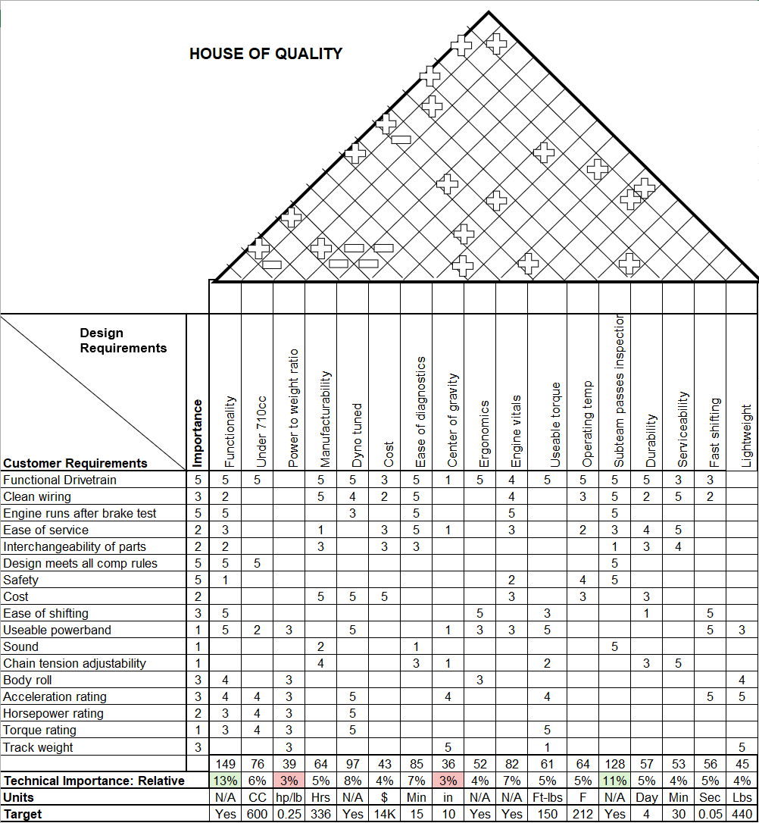
Design Requirements: QFD
Team Priorities:
Functionality (13%)
Sub-Team Pass Inspection (11%)
Dynamometer Tuned (8%)
Ease of Diagnostics (7%)
Team Non Priorities:
Power to Weight Ratio (3%)
Center of Gravity (3%)

Slide 7
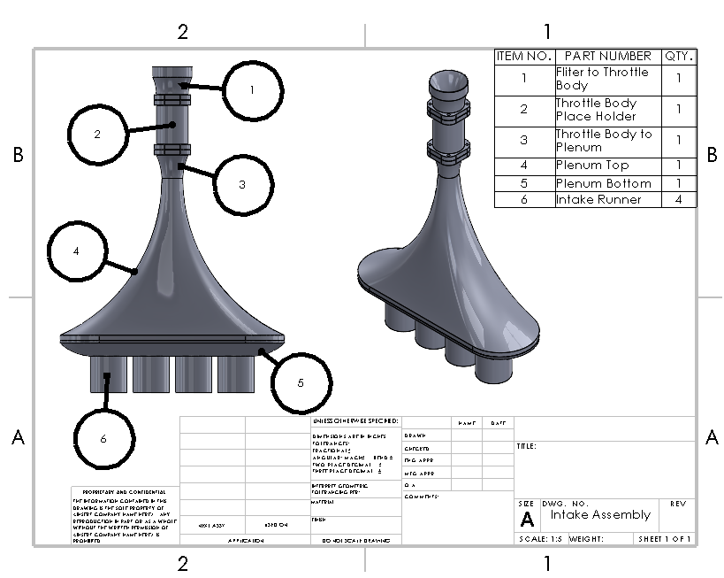
Design Description: Damian
Filter to Throttle Body (1): Funnels air from the filter to the throttle body
Throttle Body (2): Regulates air flow for the rest of the intake system
Throttle Body to Plenum (3): Funnels air from the throttle body to the restrictor at the top of the plenum
Plenum Top (4): Area for air to redistribute and restabilize
Plenum Bottom (5): Funnels air into the intake runners
Intake Runners (6): Funnels air into the engine

Slide 8
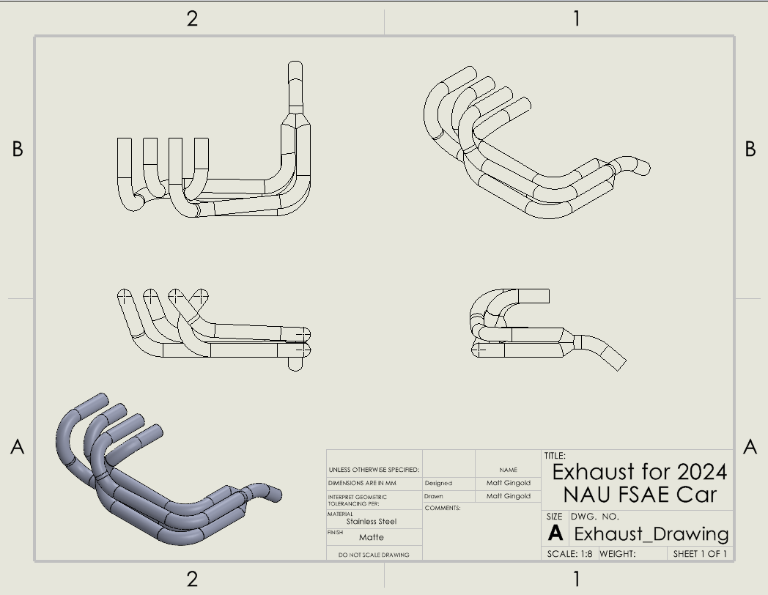
Design Description: Matt
Long tube headers
Stainless steel
Roughly equal length tubes
Side exit over rear exit
Minimal bends
40mm rather than 33.2mm

Slide 9
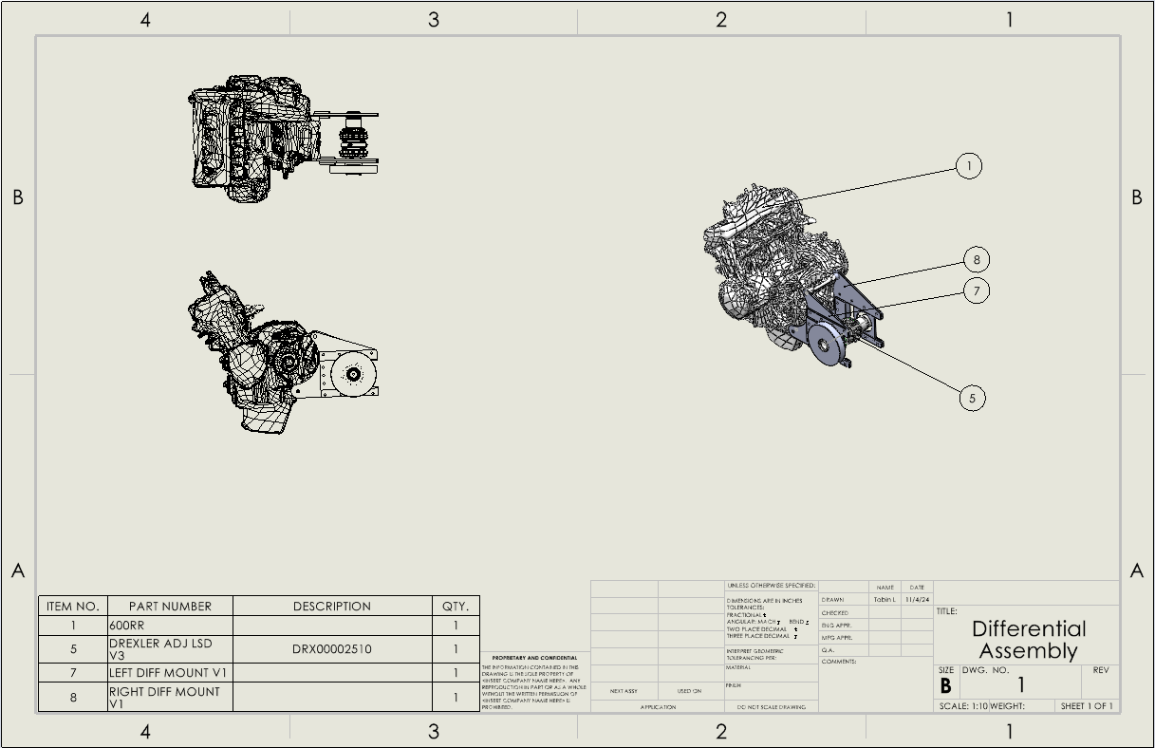
Design Description: Tobin

Slide 10
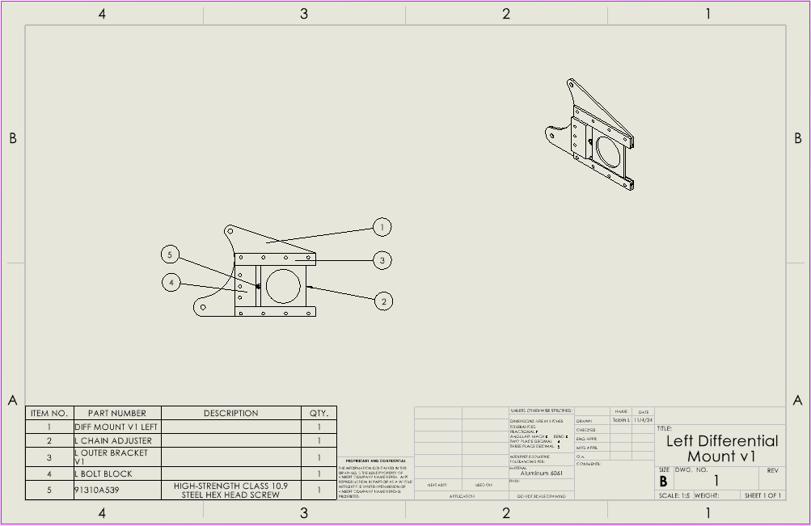
Design Description: Tobin
Bearings mount in chain adjuster plate (2)
Chain adjuster plate (2) is allowed to slide horizontally between the mount (1) and the outer bracket (3)
Adjusting bolt (5) allows for horizontal positioning of the adjuster plate (2)

Slide 11
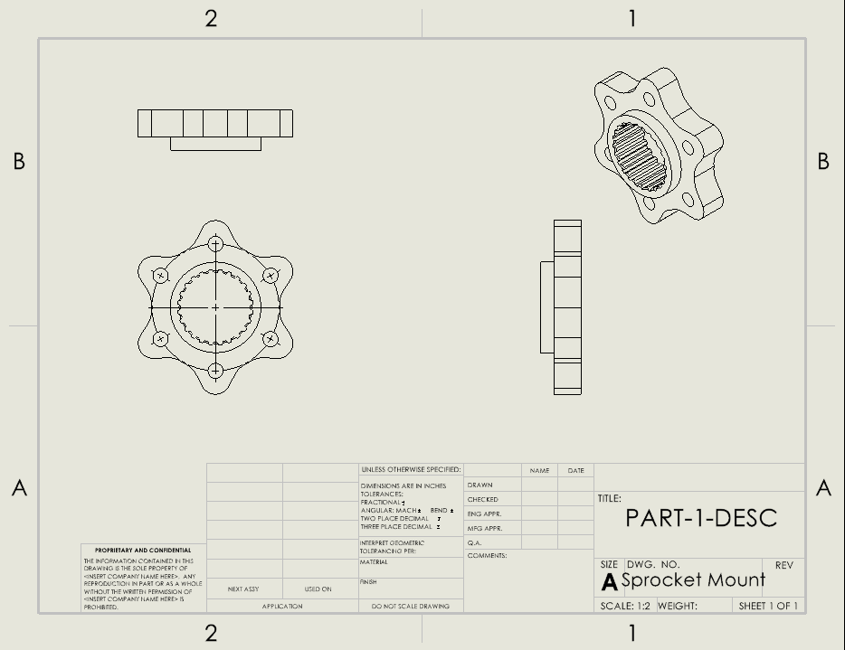
Design Description: Lucille
7075 Aluminum
The width at the base (near the center) should be about 10-15% of the sprocket diameter
Aim for a radius of curvature equal to about 15-20% of the total wing length.
Needs to align with the rear sprocket with the front sprocket
Rear Sprocket will attach to the mount, which is placed on the Drexler

Slide 12
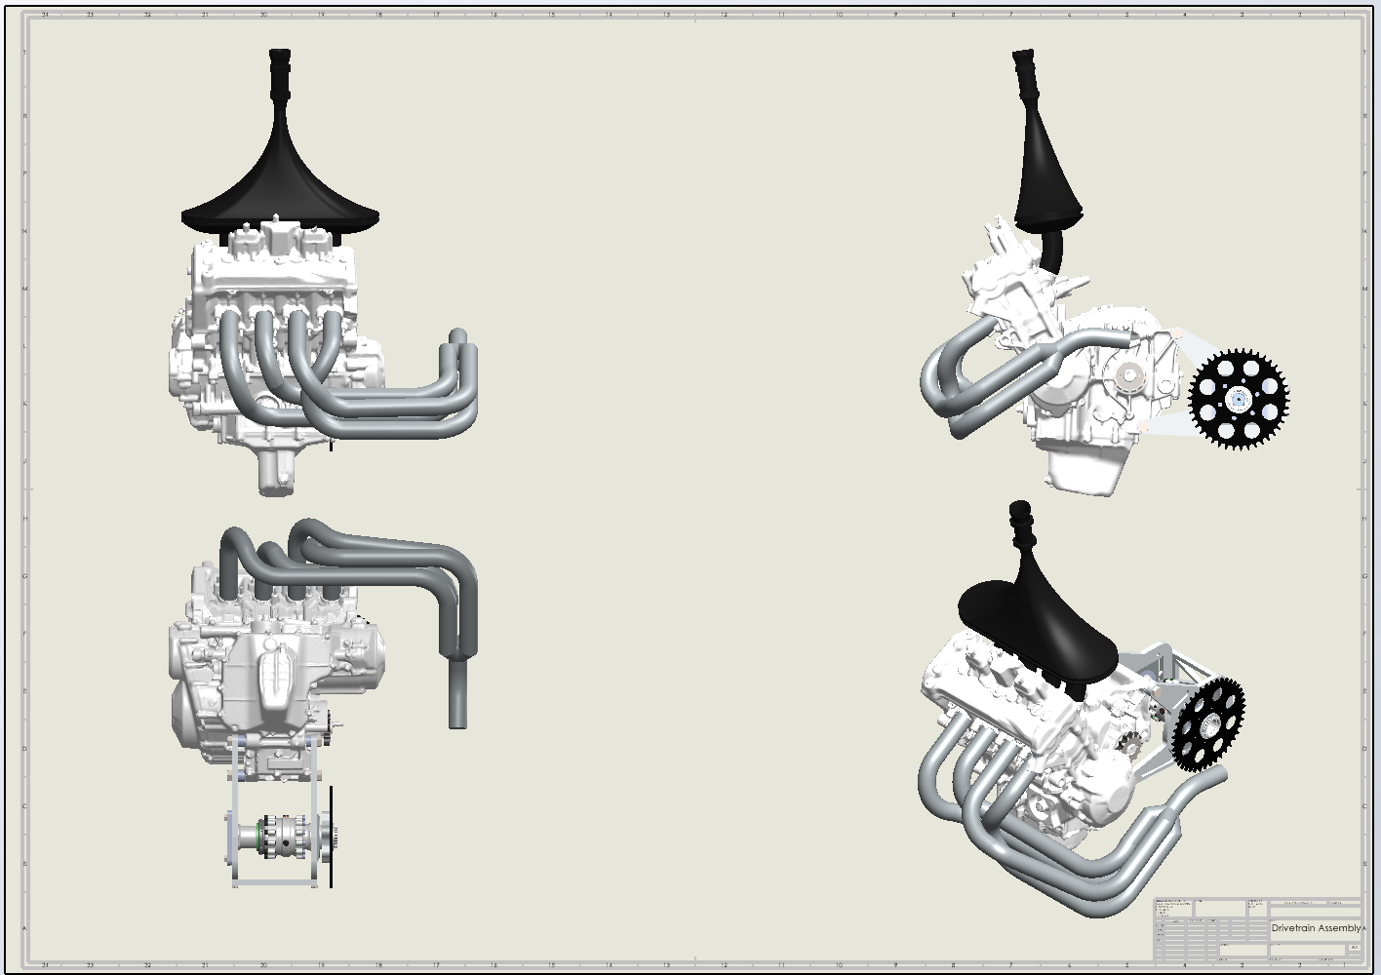
Design Description: Joey

Slide 13
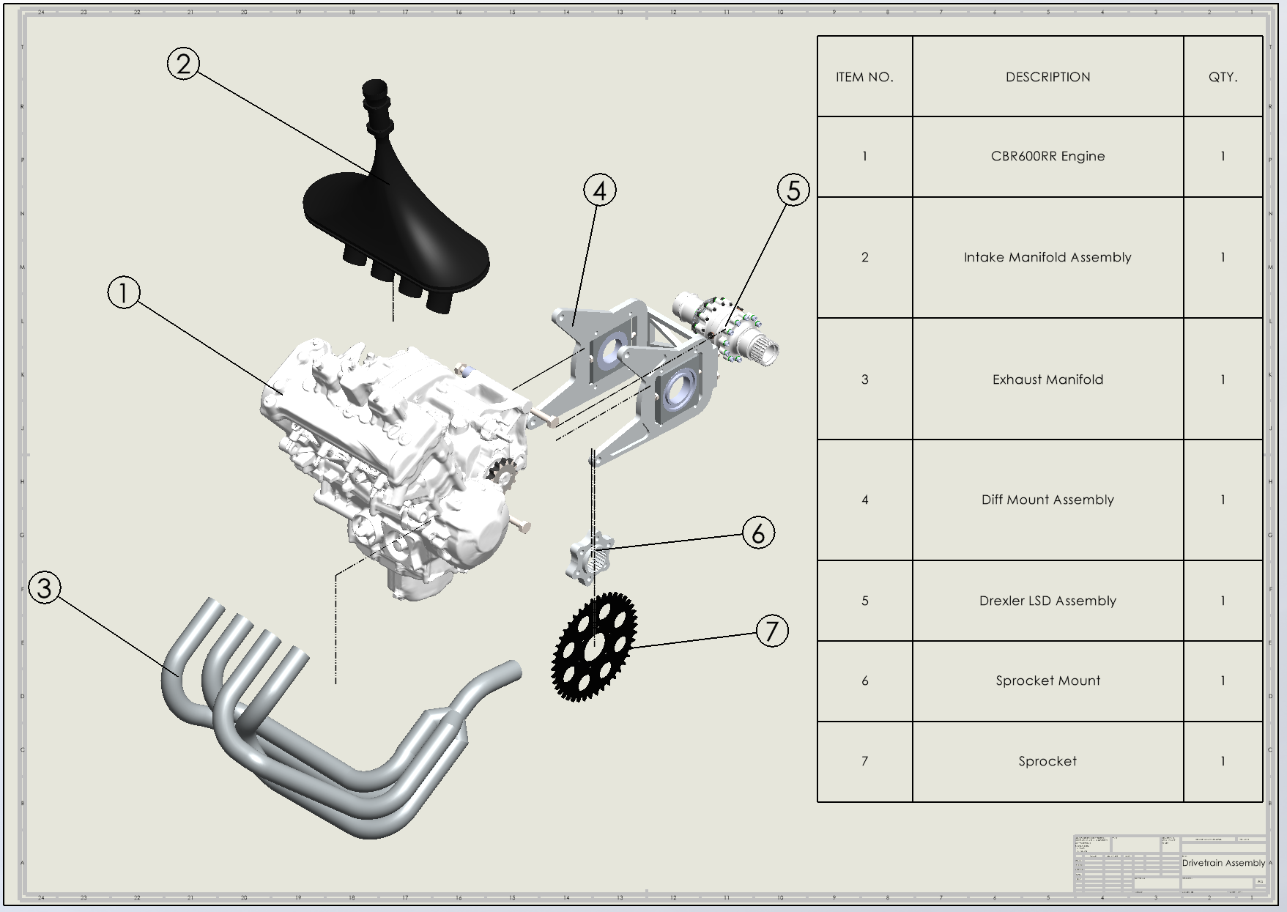
Design Description: Joey

Slide 14
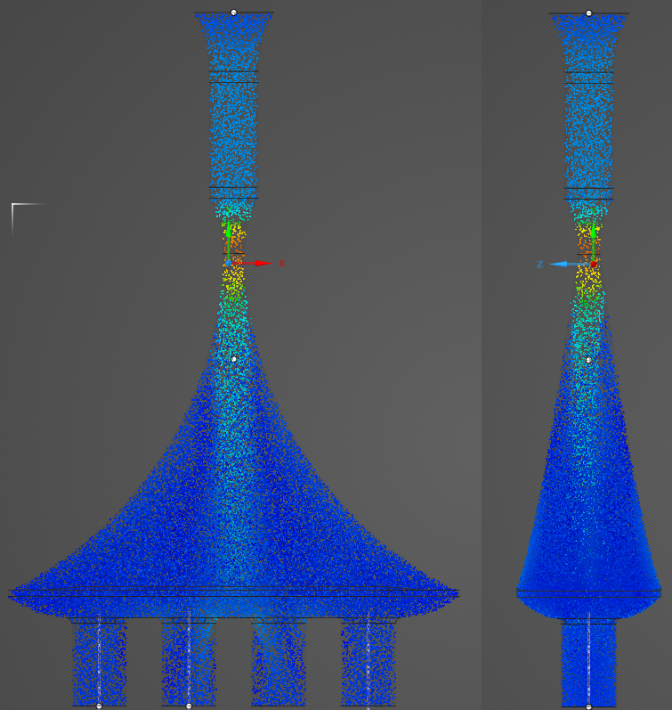
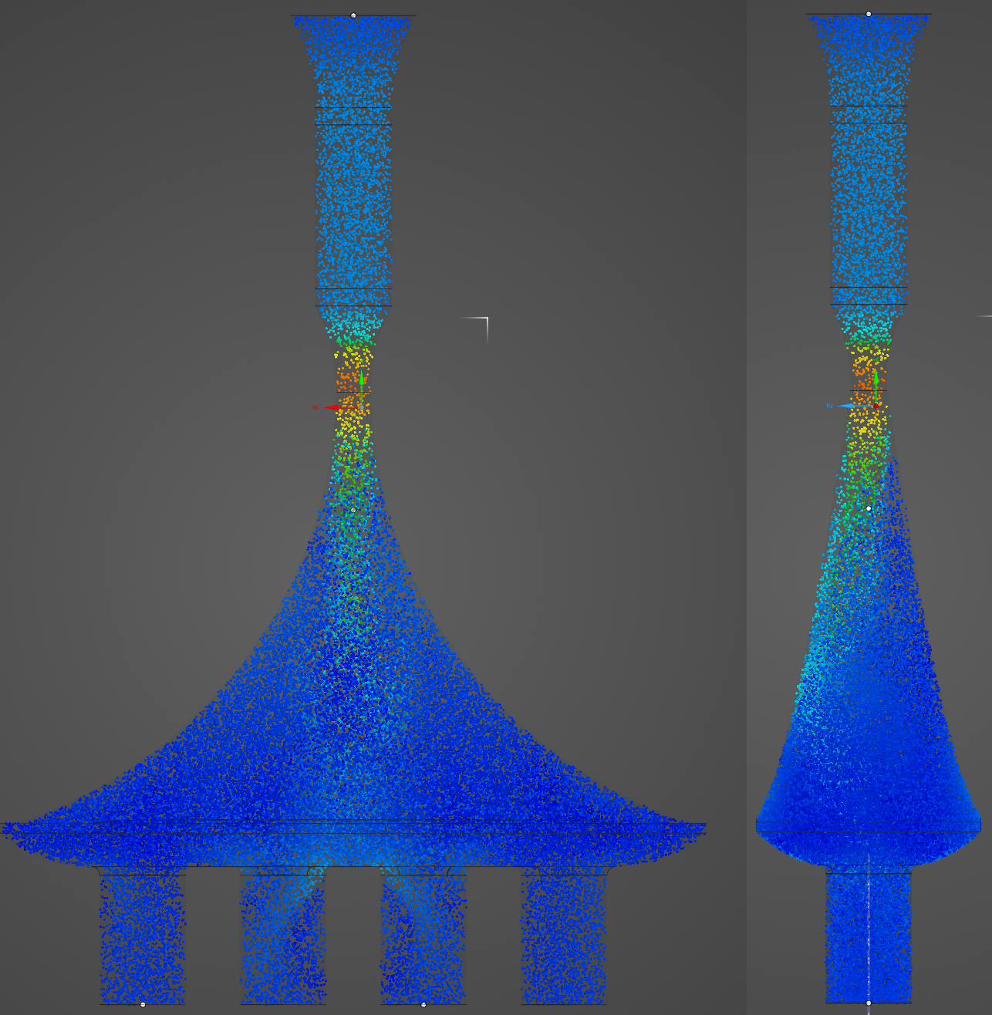
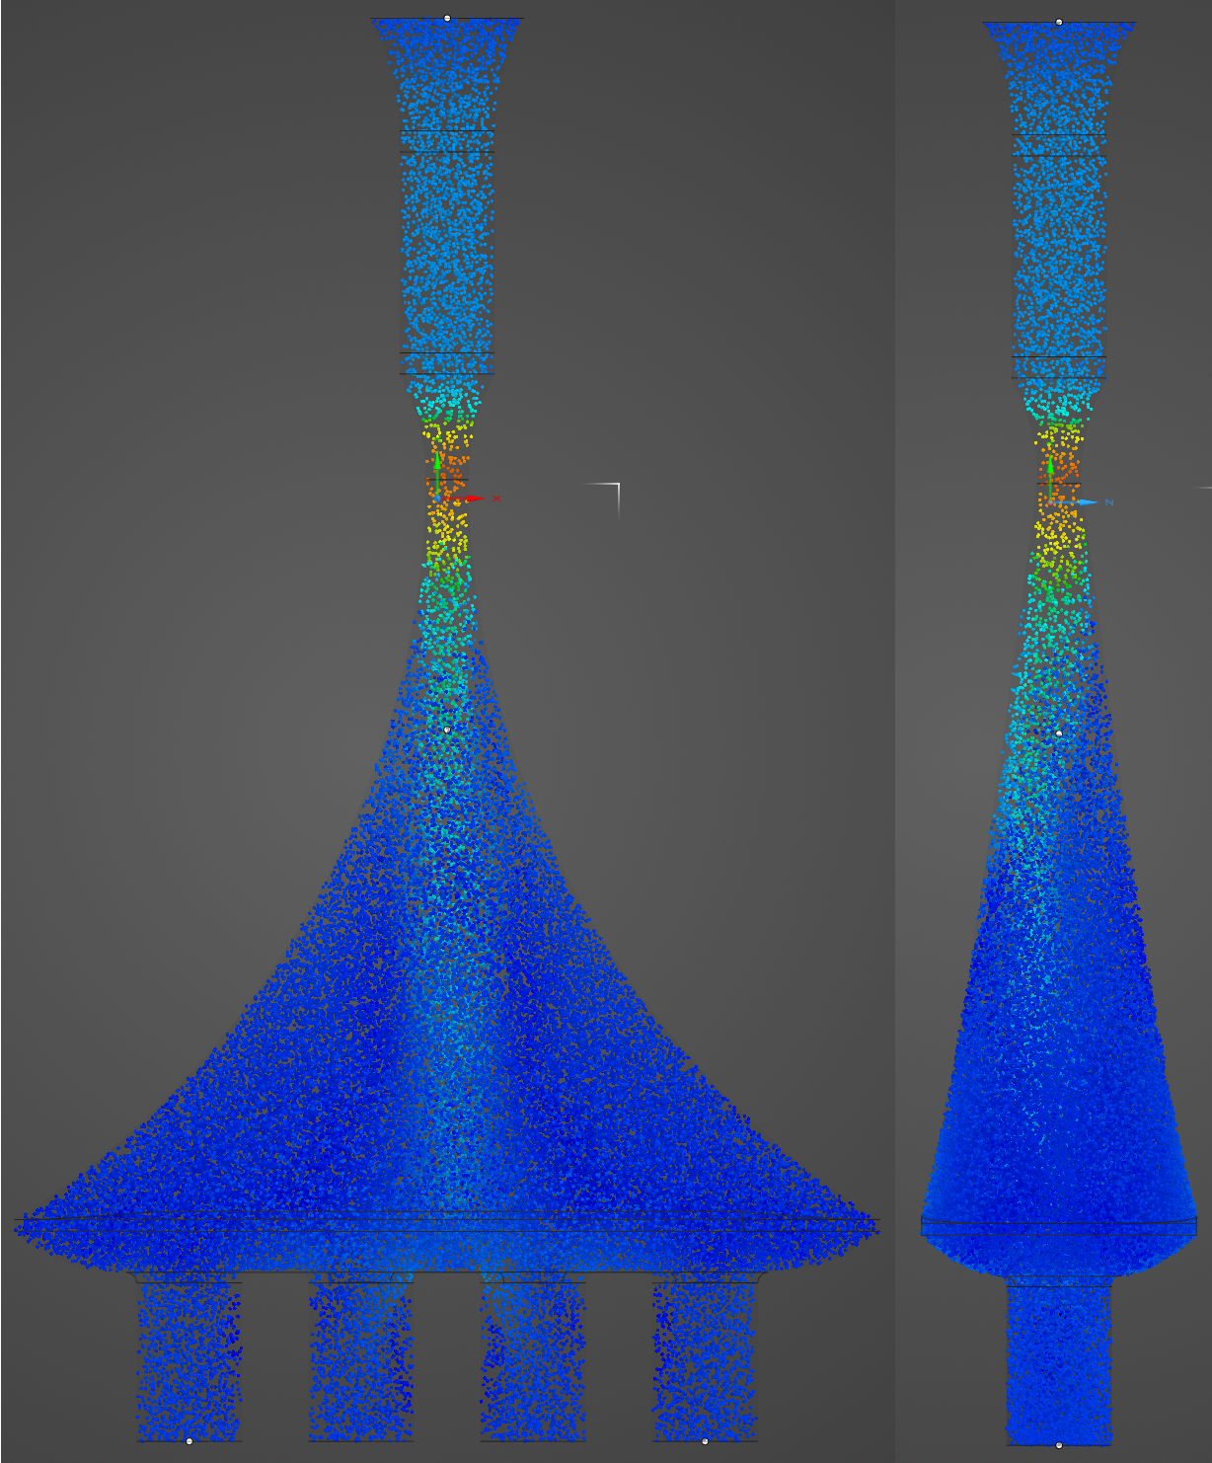
Engineering Calculations: Damian
Unquantified ERs and CRs: Functional, Cost, Usable Powerband, Horsepower and Torque ratings, Manufacturability, Sub-Team Passes Inspection. Using ANSYS, SolidWorks, and Matlab these can quantified.
Parameters: Air, Steady State, Inlet Pressure of 101,325 pa, Outlet Mass Flow Rate of 0.0714 Kg/sec
Design 1
Design 2
Design 3
Top Plenum Length of 300mm
Top Plenum Length of 250mm
Top Plenum Length of 350mm

Slide 15
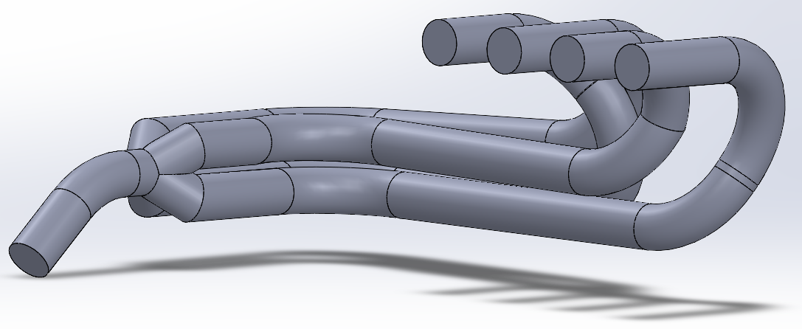
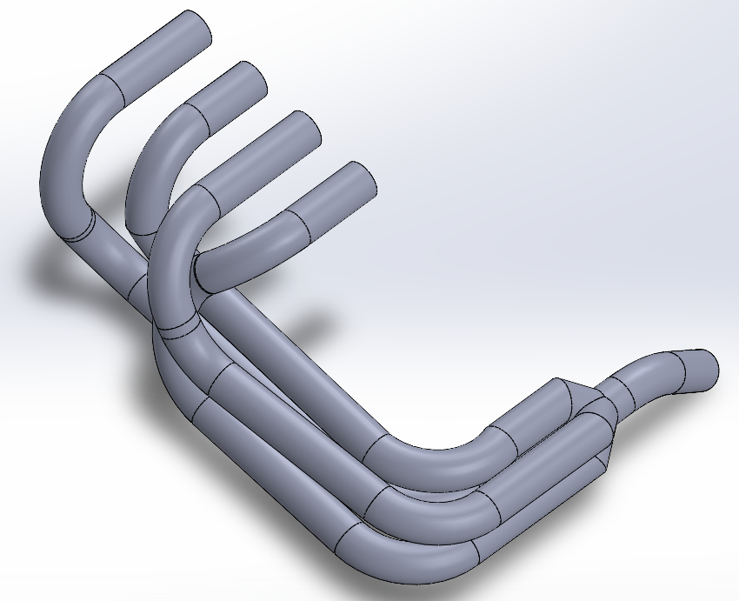
Engineering Calculations: Matt
Runner 1: ~ 860mm
Runner 2: ~ 830mm
Runner 3: ~ 790mm
Runner 4: ~ 860mm
8% difference from shortest to longest
Equal length:
Good for power
Simple
Non-equal length:
Slightly less power at top end*
Experiment with sound
Better when fitment is an issue

Slide 16
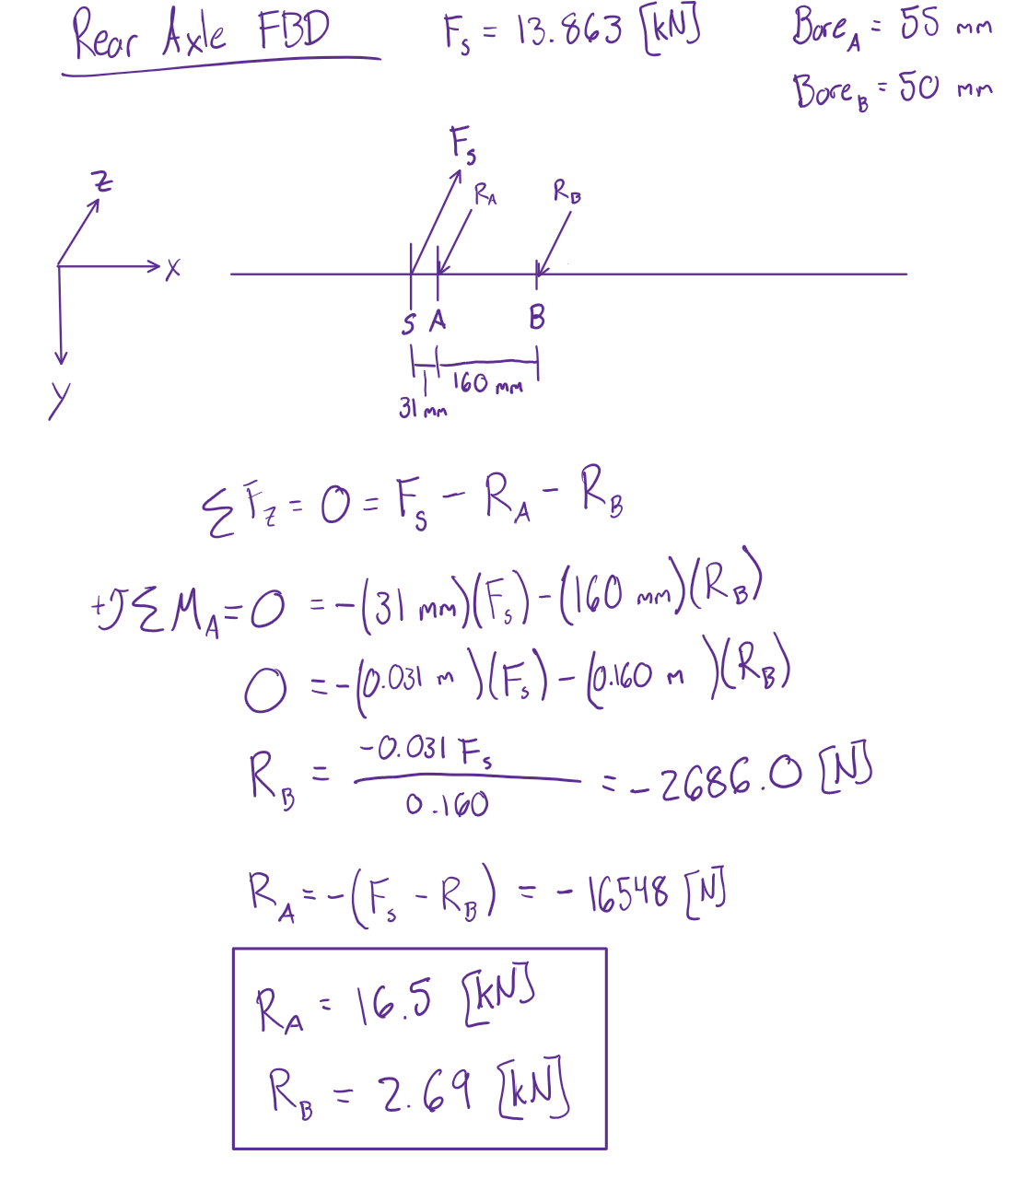
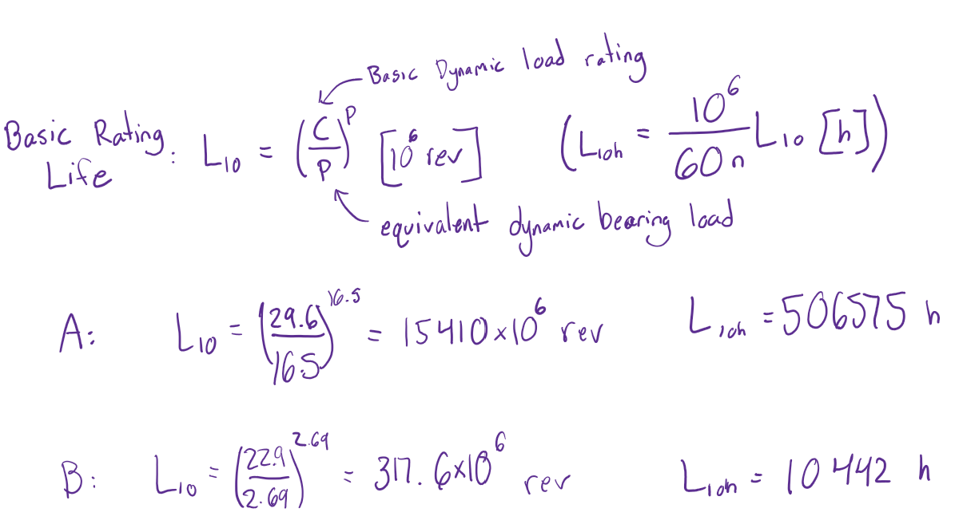
Engineering Calculations: Tobin
Reaction Forces at Bearings A and B
Bearing Rating Life
(From SKF Selection Catalogue)

Slide 17
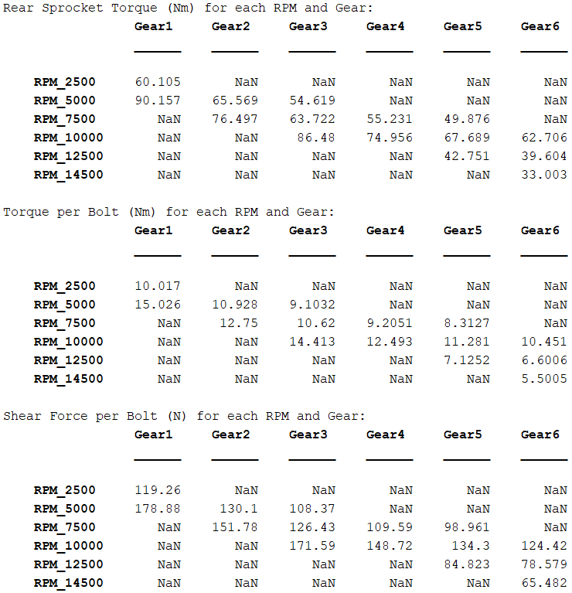
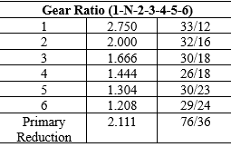
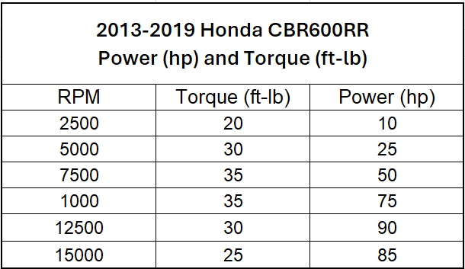
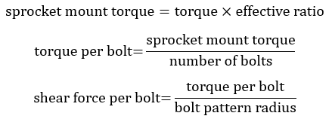
Engineering Calculations: Lucille

Slide 18
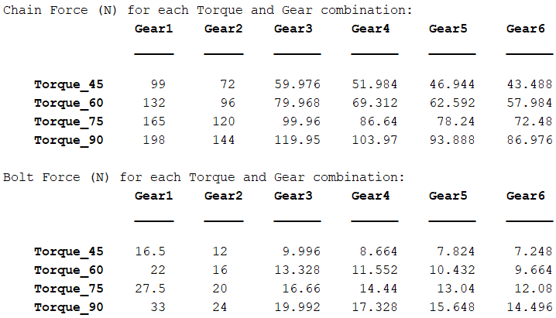
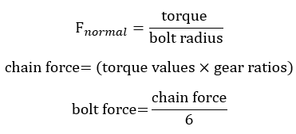
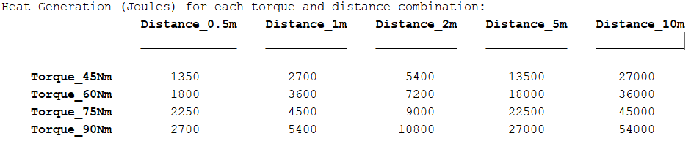

Engineering Calculations: Lucille
Parameters:
Bolt Diameter: 10e-3 (m)
Coefficient of Friction= 0.3

Slide 19
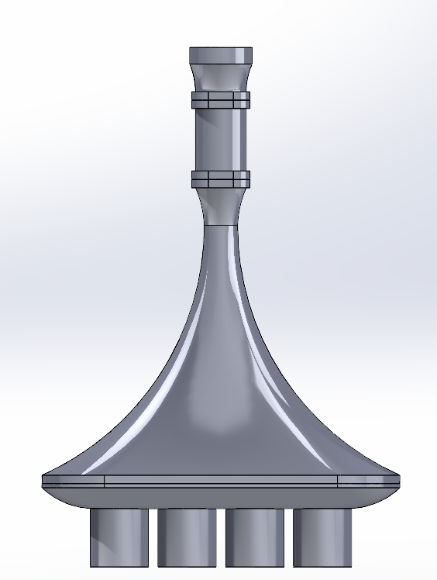
Design Validation:Intake Manifold
Risk Trade-Off Analysis:
Keeps us passing tech for the races
Allows for better airflow to each cylinder
Will use 3D printers using plastic which is lighter than metals (ones we could use)
If the print messes up, it is not too hard to just start another one
Possible Critical Failure Points: All result in Tech. Failures
Poor support leading to breaking
  ANSYS Analysis and Testing
Melting of intake due to engine heat
  High Temp. 3D Plastics and Testing
Poor print result leaving the restrictor bigger than expected
  Testing and Knowing Printer Over Extrusion Measurement
Testing:
Using a Dynamometer to run the engine to temp. the team will read pressures within the intake and record output power and torque
Space: 47A/Machine Shop or Other School
Equipment: Telescoping Gauge, Pressure Transducers, IR Camera/Temperature Sensor, Dynamometer

Slide 20
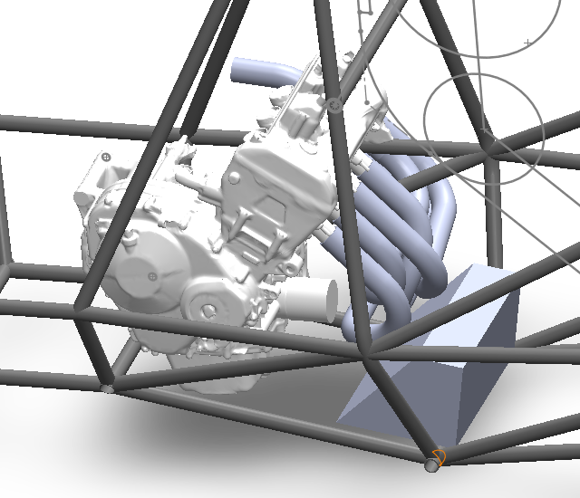
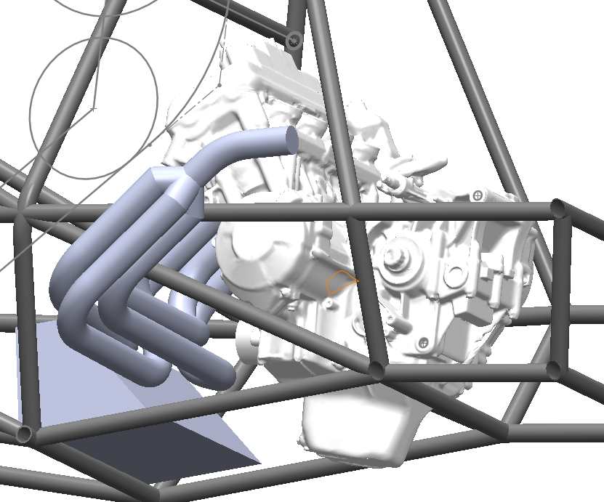
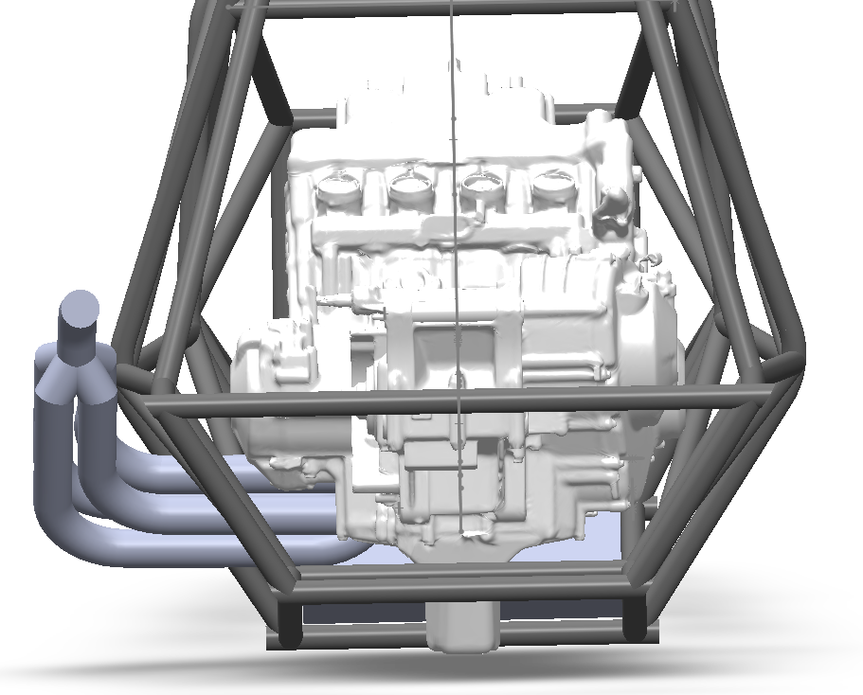
Design Validation:Exhaust
Possible Failure Points:
Exhaust overheating
  Selected Stainless steel for heat dissipation
Fatigue failure (vibration)
  Also selected stainless steel for this reason
Welds failing
  We will have a trained welder creating the final part
Keeps benefits of longer tube headers while only having an 8% difference
Lowers engine (side exit vs underneath)
Keeps room for a gas tank that can easily hold roughly 7 liters (1.85 gallons)
Stainless steel is great at heat dissipation (will still need a heat shield)
Makes oil changes easier

Slide 21
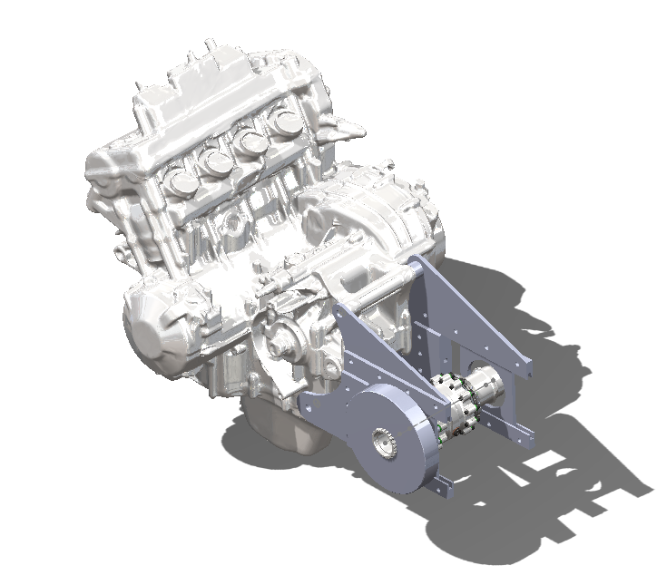
Design Validation: Diff. Mounts
Allows for proper chain tensioning with easy, on-the-fly, adjustments.
Utilizes motor mount locations for inherent strength.
Horizontal adjustability prevents axle from colliding with frame members.
Possible Failures | Effects | Prevention
Stripping of jack nuts and/or bolts | Loss of chain tension adjustability | Selected high strength steel bolts
Excessive deformation in mounting brackets | Misalignment and possible damage to Drexler LSD | FEA to determine deformation and factor of safety against expected loading scenarios
Overheating bearings | Premature wear on bearings and increased friction | Selected bearings with improved heat dissipation and high rpm ratings

Slide 22
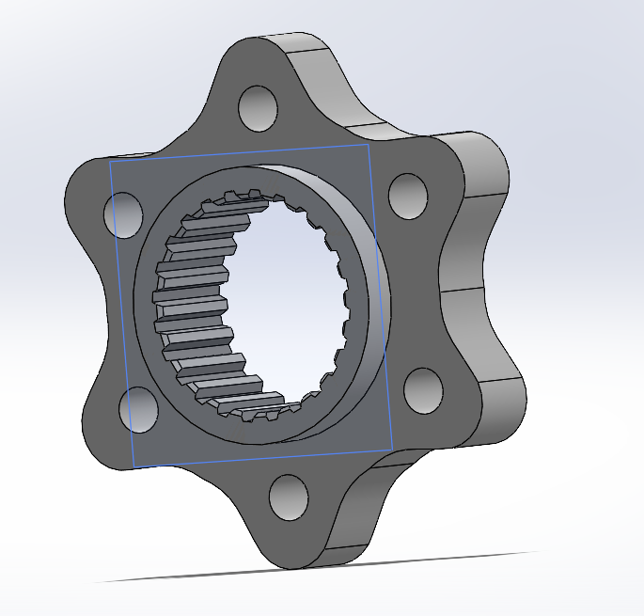
Design Validation: Sprocket
Allows for easy mounting of the sprocket
Aligns with the front and rear sprocket
Keeps everything in line so the chain does not get torqued
Uses aluminum over steel (for weight)
Will be made out of the stand for the differential so we do not have to design any splines
Factor of Safety: 2
Possible Failure Modes:
Over torqued bolts leading to sheering
  M10 bolts
Bracket deforming allowing for the chain to get torqued
  Strong enough to handle someone mashing the throttle and brake simultaneously
Vibration from improperly balanced weight slowly causing a fatigue failure
  Symmetrical in order to have little to no vibrations

Slide 23
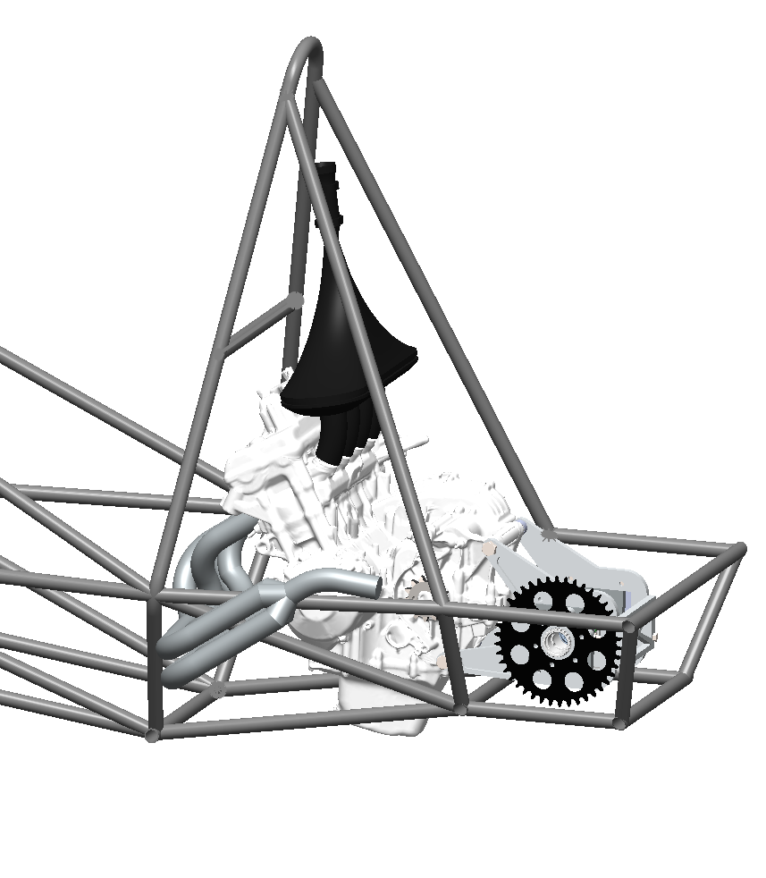
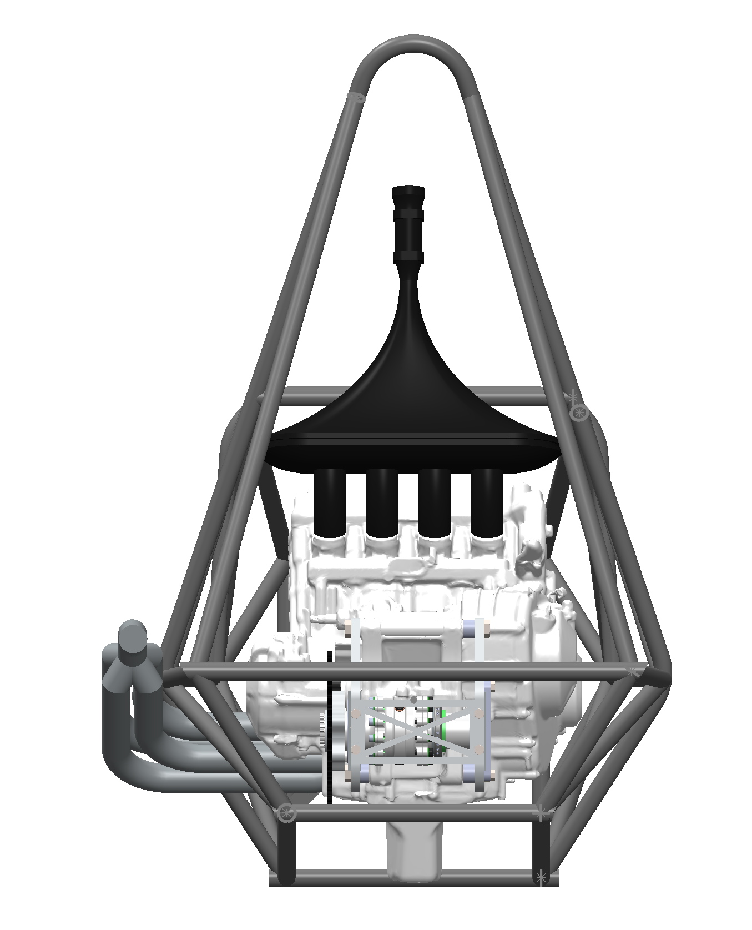
Design Validation: Drivetrain Assembly

Slide 24
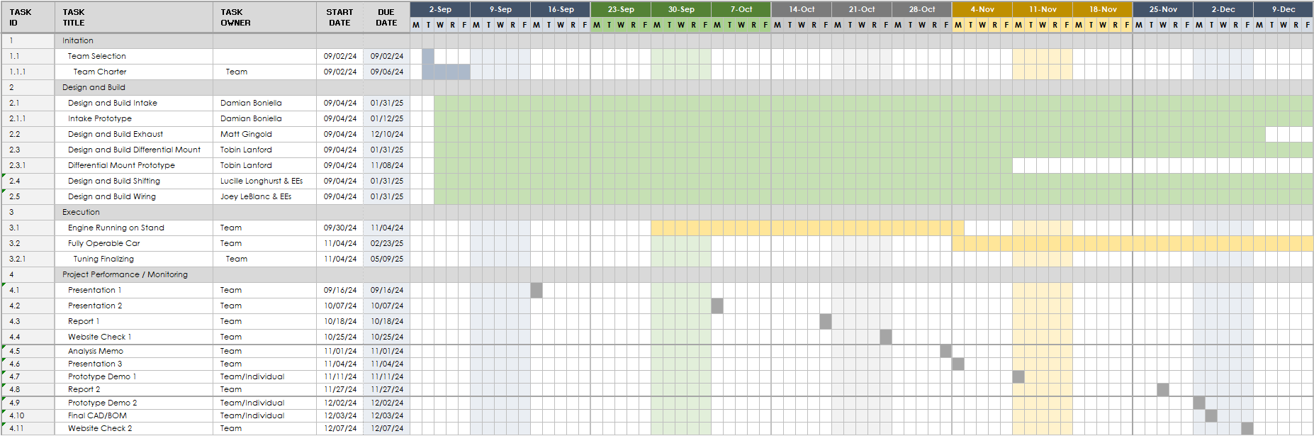
Gantt Chart

Slide 25
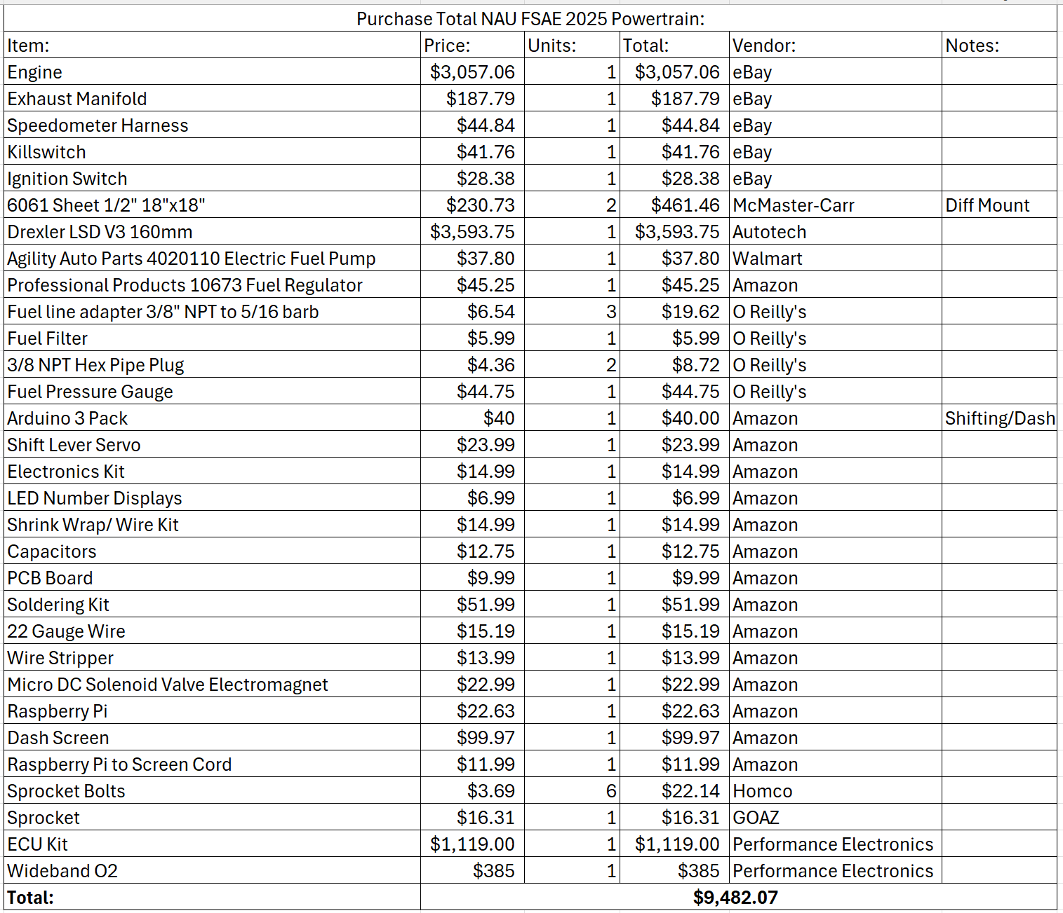
Budget

Slide 26
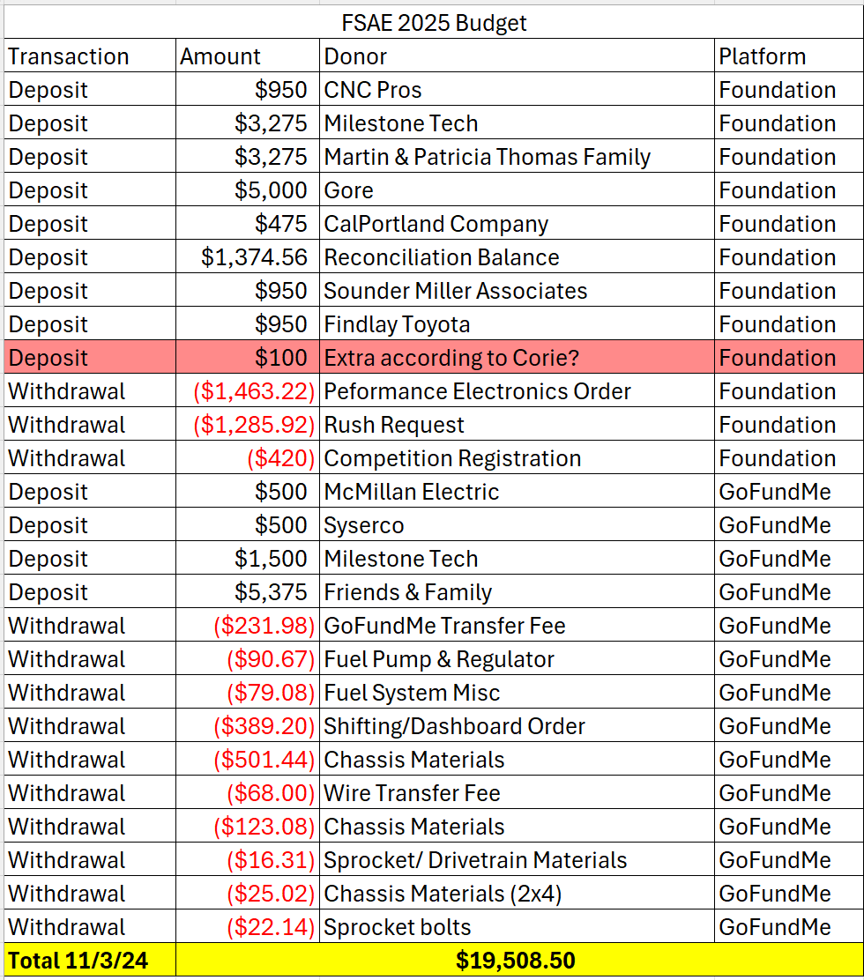
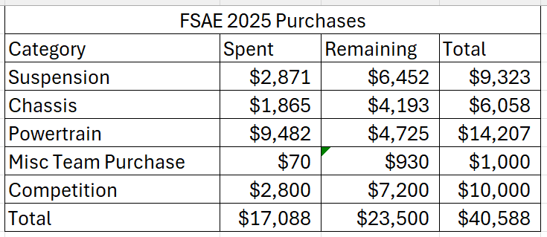
BUDGET

Slide 27
CONCLUSION
Parts Still need to Undergo ANSYS:
Sprocket Mount (Static Structural Analysis)
Intake (ANSYS Fluent)
Exhaust (ANSYS Fluent)
Differential Mounts (Static loading and fatigue analysis)
Parts being prototyped (3D printed in Idea Lab)
Sprocket Mount
Upper Intake Components
Differential Mounts
Updates & Goals
Got Engine Running!
  Maintenance
Continue to earn Sponsorships

